Slide 1

AirBnB Price Prediction
PRAGATHEESWARAN R
ADITHYA M
SIDHARTHEN R
AANAND R
AJEET ADETEEA S U

Slide 2


Slide 3


Slide 4

Problem Statement
Airbnb wants its hosts to set their own prices.
Fixing the right price for the listing is not something a new host would expertise in.

Slide 5
Data Source
The data was extracted from the website http://insideairbnb.com/get-the-data.html
106 features and 20495 rows.
52 features 16038 rows.
Listing and Review file.

Slide 6

Sentiment Analysis

Slide 7
Data Cleaning
Special Characters like “ % ”, ” $ ”, ” , ” are removed from the price column.
Features like ['host_has_profile_pic’,'host_identity_verified','host_is_superhost','is_location_exact','requires_license','instant_bookable','is_business_travel_ready','require_guest_profile_picture','require_guest_phone_verification','has_availability’]
is typecasted to bools(‘ True’ and ‘ False ’) since these features contains values
as ‘ t ’ and ‘ f ’.
Dropped the columns that has more than 80% of null values.
Then, Features like URL, ID, Names, Description are removed since they contain unique vatlues and in description feature it contains only words so that’s the reason we removed it.
In some columns the null values are less than 0.1 % so we removed that features why because these columns follows a particular pattern(theses features have null null values in the same instance.)
After the treatment of features, from 106 columns and 20495 rows we cut down to 55 columns and 20382 rows.

Slide 8
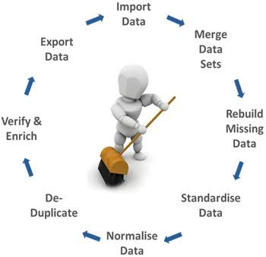
Exploratory Data Analysis

Slide 9
Missing values imputation
In order to handle the missing values we split the data into two parts numerical and categorical.
Missing Values Imputation
Categorical Imputation method:
All the columns in this data frame are categorical we will use mode imputation for these data.
Numerical Imputation method:
Here, we used Iterative imputer from sklearn which is one of the advanced imputation techniques.

Slide 10
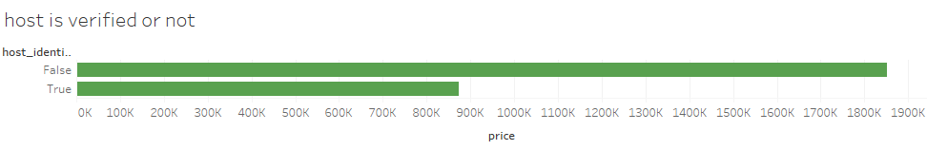
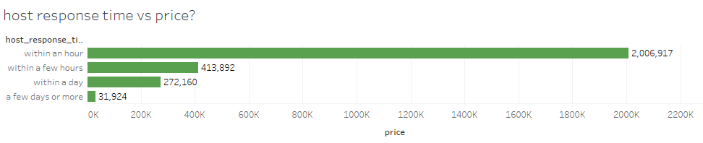
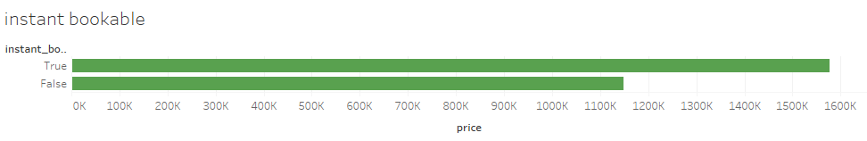
Insights

Slide 11
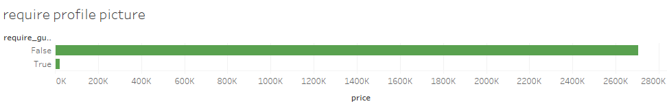
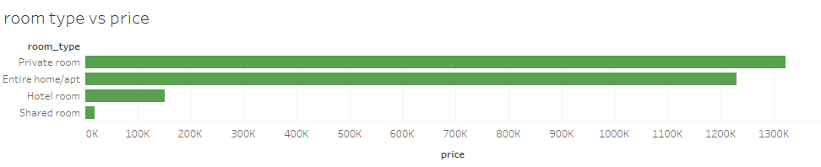

Slide 12
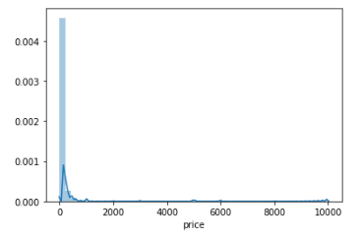
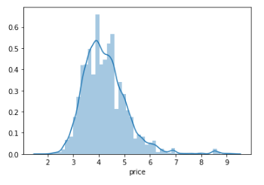
Since the target variable is positively skewed we did log Transformation. After doing log transformation, price variable became normally distributed.
Transformation
Log Transformation on Target
PRICE (Target Variable)

Slide 13
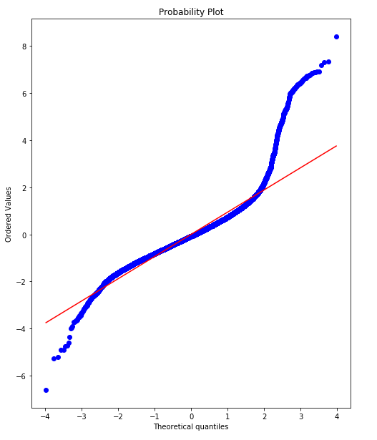
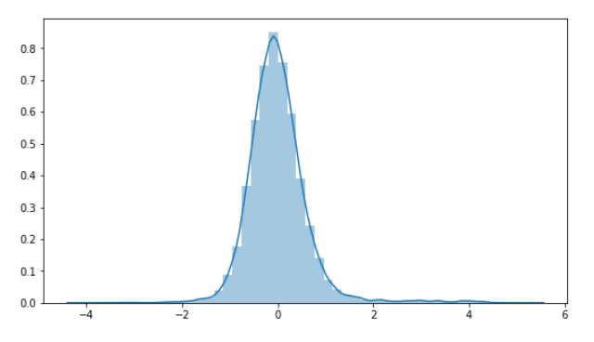
Assumptions of Linear Regression
Linearity of Residuals
Normlity of Residuals

Slide 14
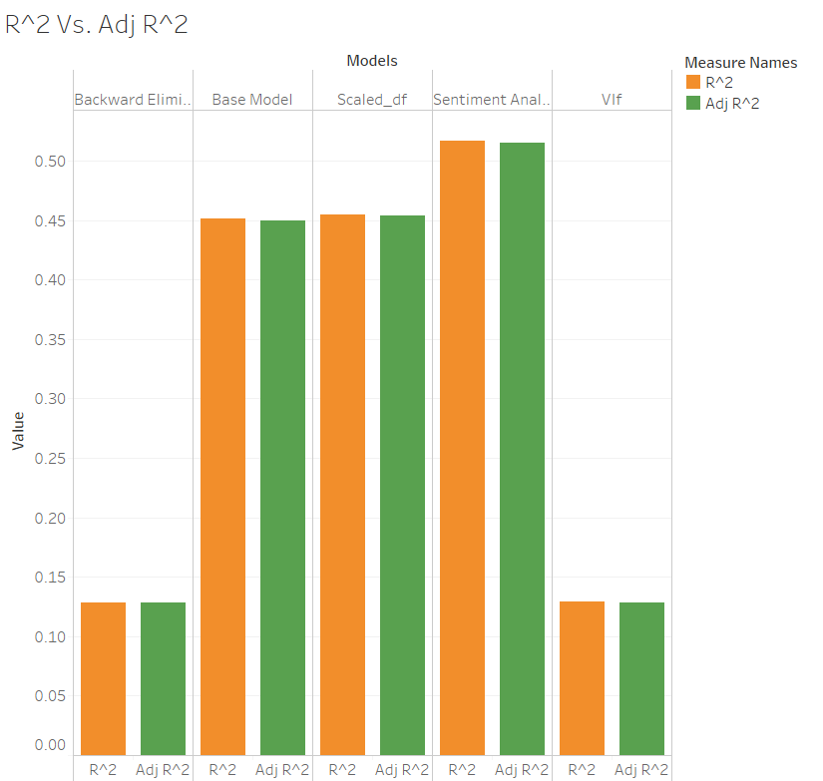

Slide 15
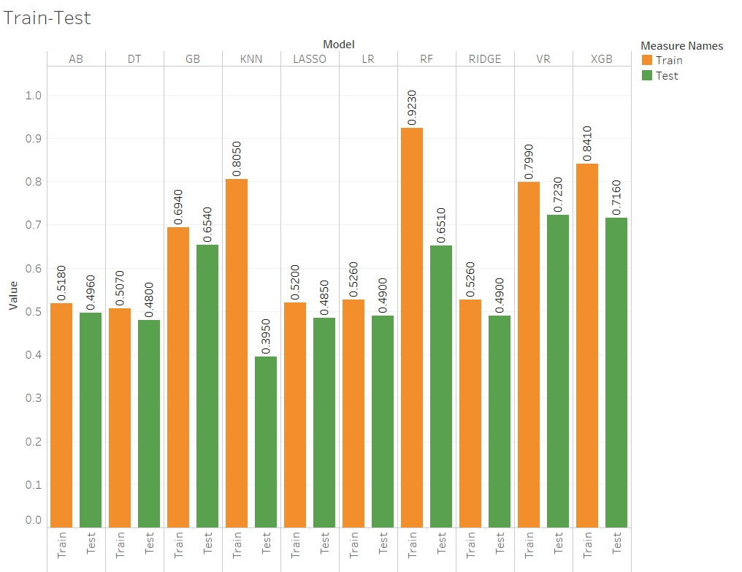
Comparison of Models-Accuracy

Slide 16
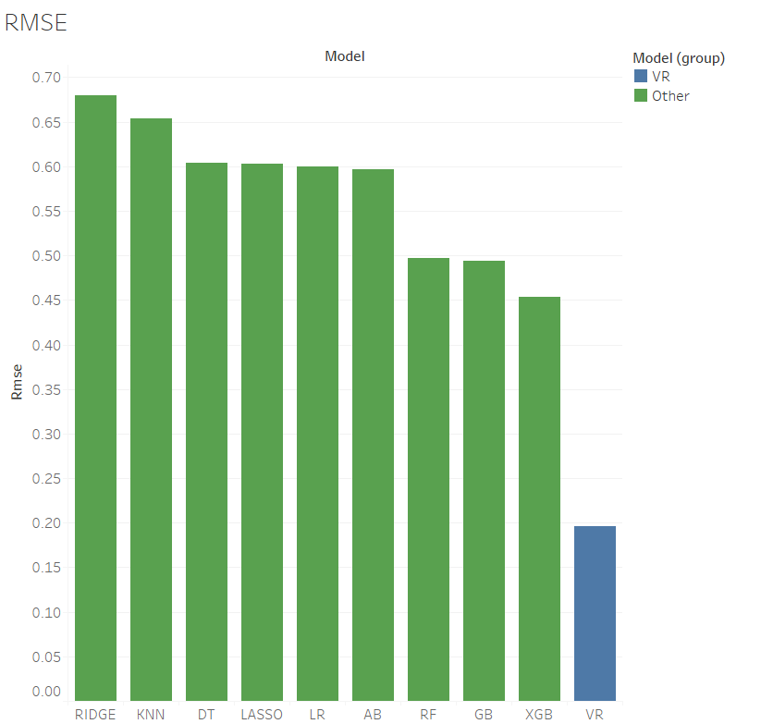
Comparison of Models-RMSE

Slide 17


Conclusion

Slide 18
Thank You !

